Slide 1
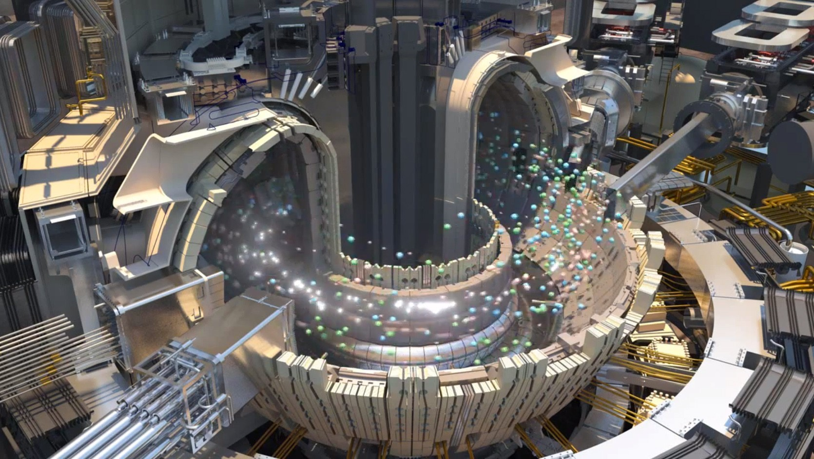
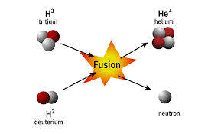
Modern & green energy solutions
ITER fusion reaction
ITER is the largest fusion machine in the world Fusion works by colliding hydrogen at high speeds Many countries contributes to complete the machine (including Denmark)
Notes:
Sources
https://www.dr.dk/drtv/se/den-groenne-optur_-kan-vi-bygge-solen-paa-jorden_323949
https://www.iter.org/

Slide 2
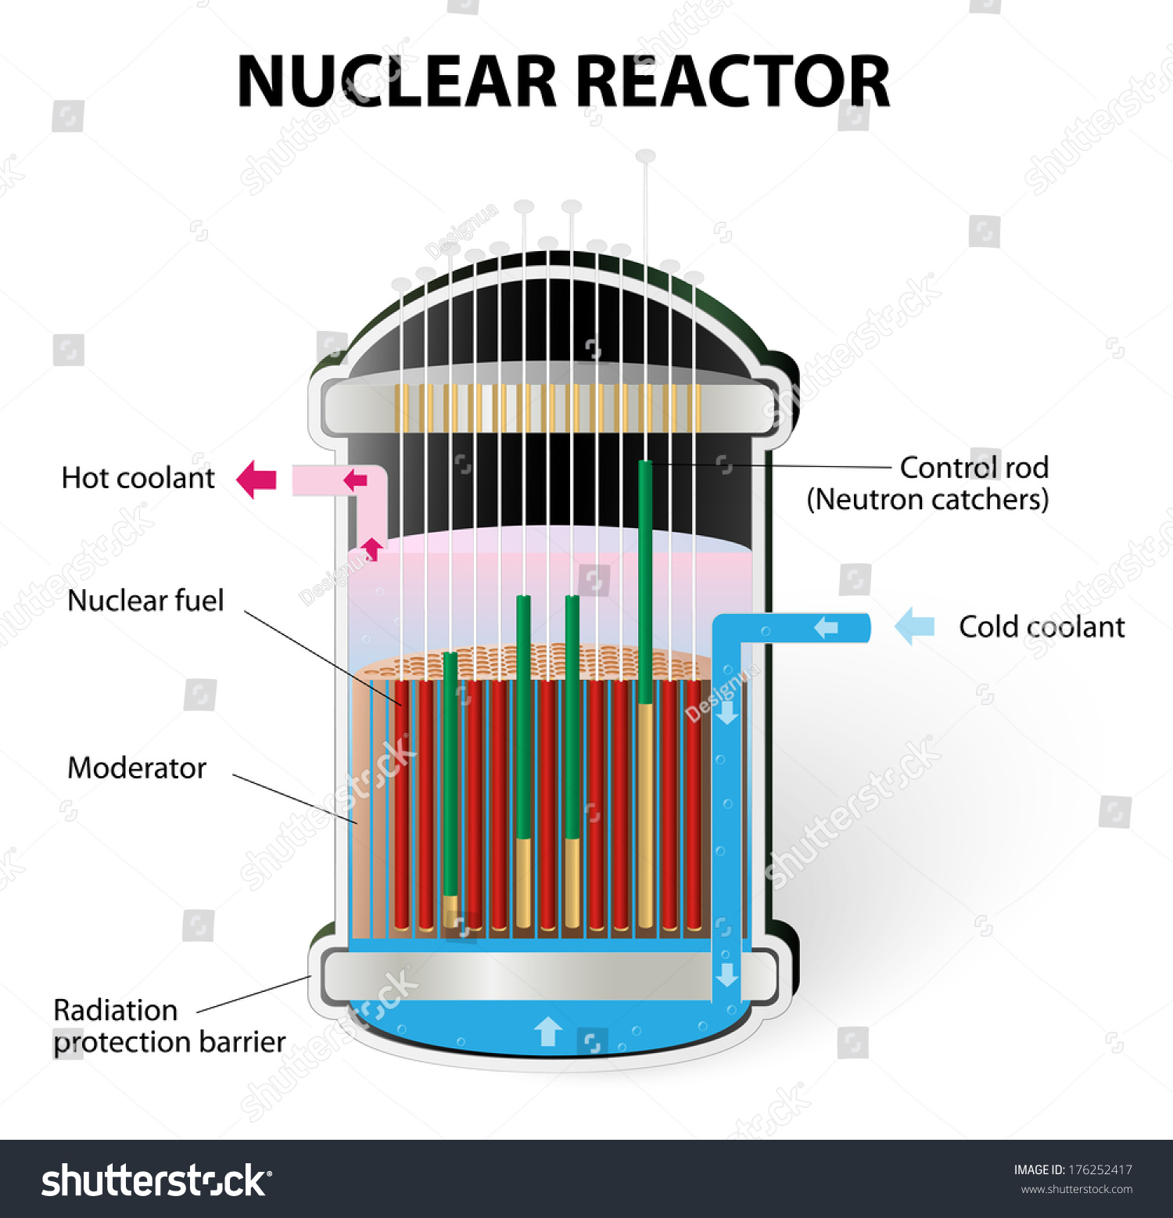
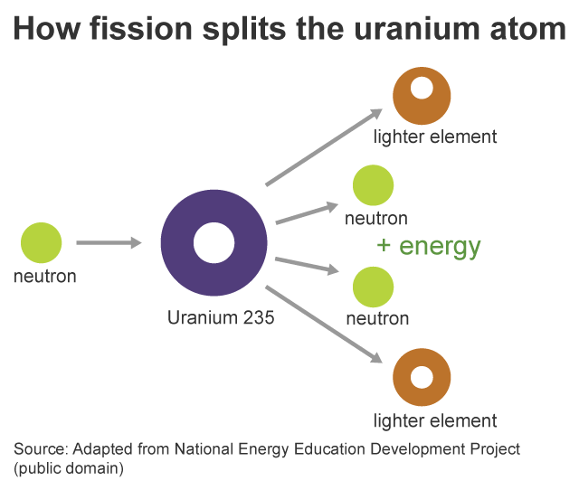
Modern & green energy solutions
Nuclear fission reaction
Fusion and fission are not the same Nuclear fission are splitting atoms fusion is the opposite Nuclear works by colliding neutrons with the radioactive substance (Uranium 235) which releases heat
Notes:
Sources https://www.eia.gov/energyexplained/nuclear/

Slide 3
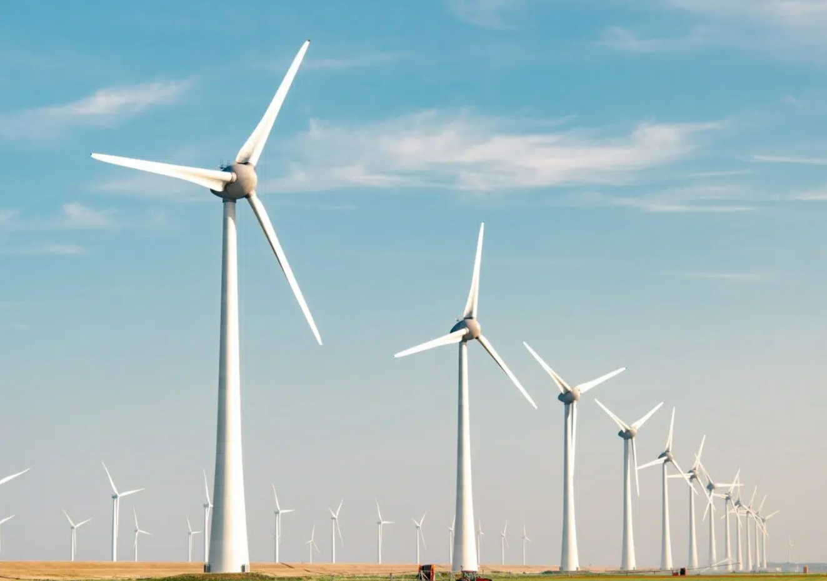

Modern & green energy solutions
Windmills & Solar panels Wind and solar panels is a green type of energy But when it’s not sunny or windy this type of energy plant is limited therefor this should be combined with nuclear or fusion (once accessible)
Notes:
Sources My knowledge

Slide 4
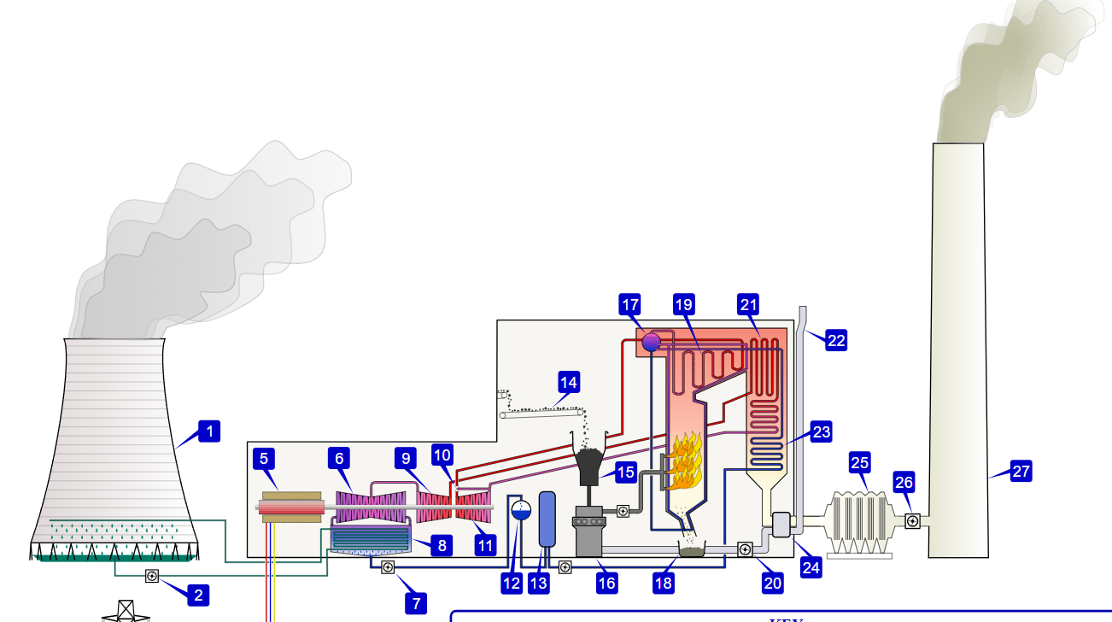
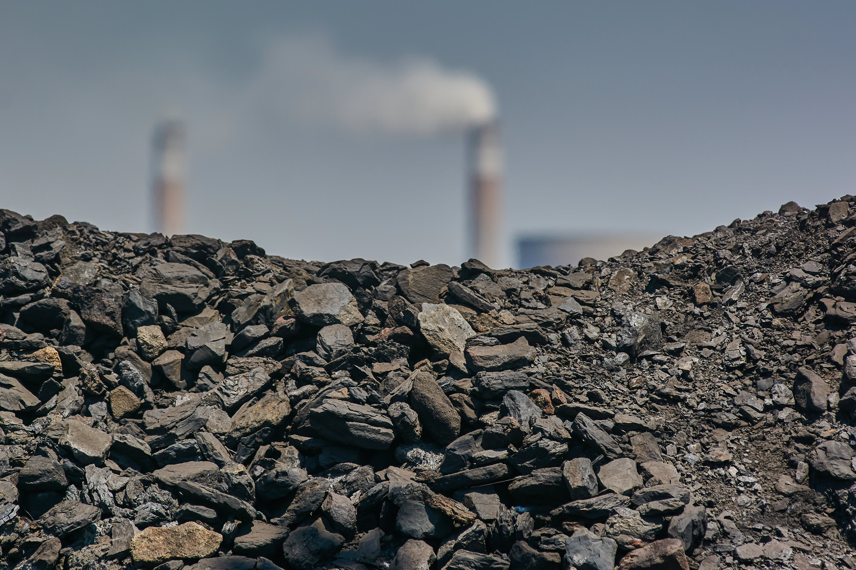
Fossil fuels
Coal-fired power station Operating a coal-fired power station emits 820 grams of Co2 for every kWh which is the highest Co2 emission out of all the fuel types
Notes:
Sources https://en.wikipedia.org/wiki/Coal-fired_power_station

Slide 5
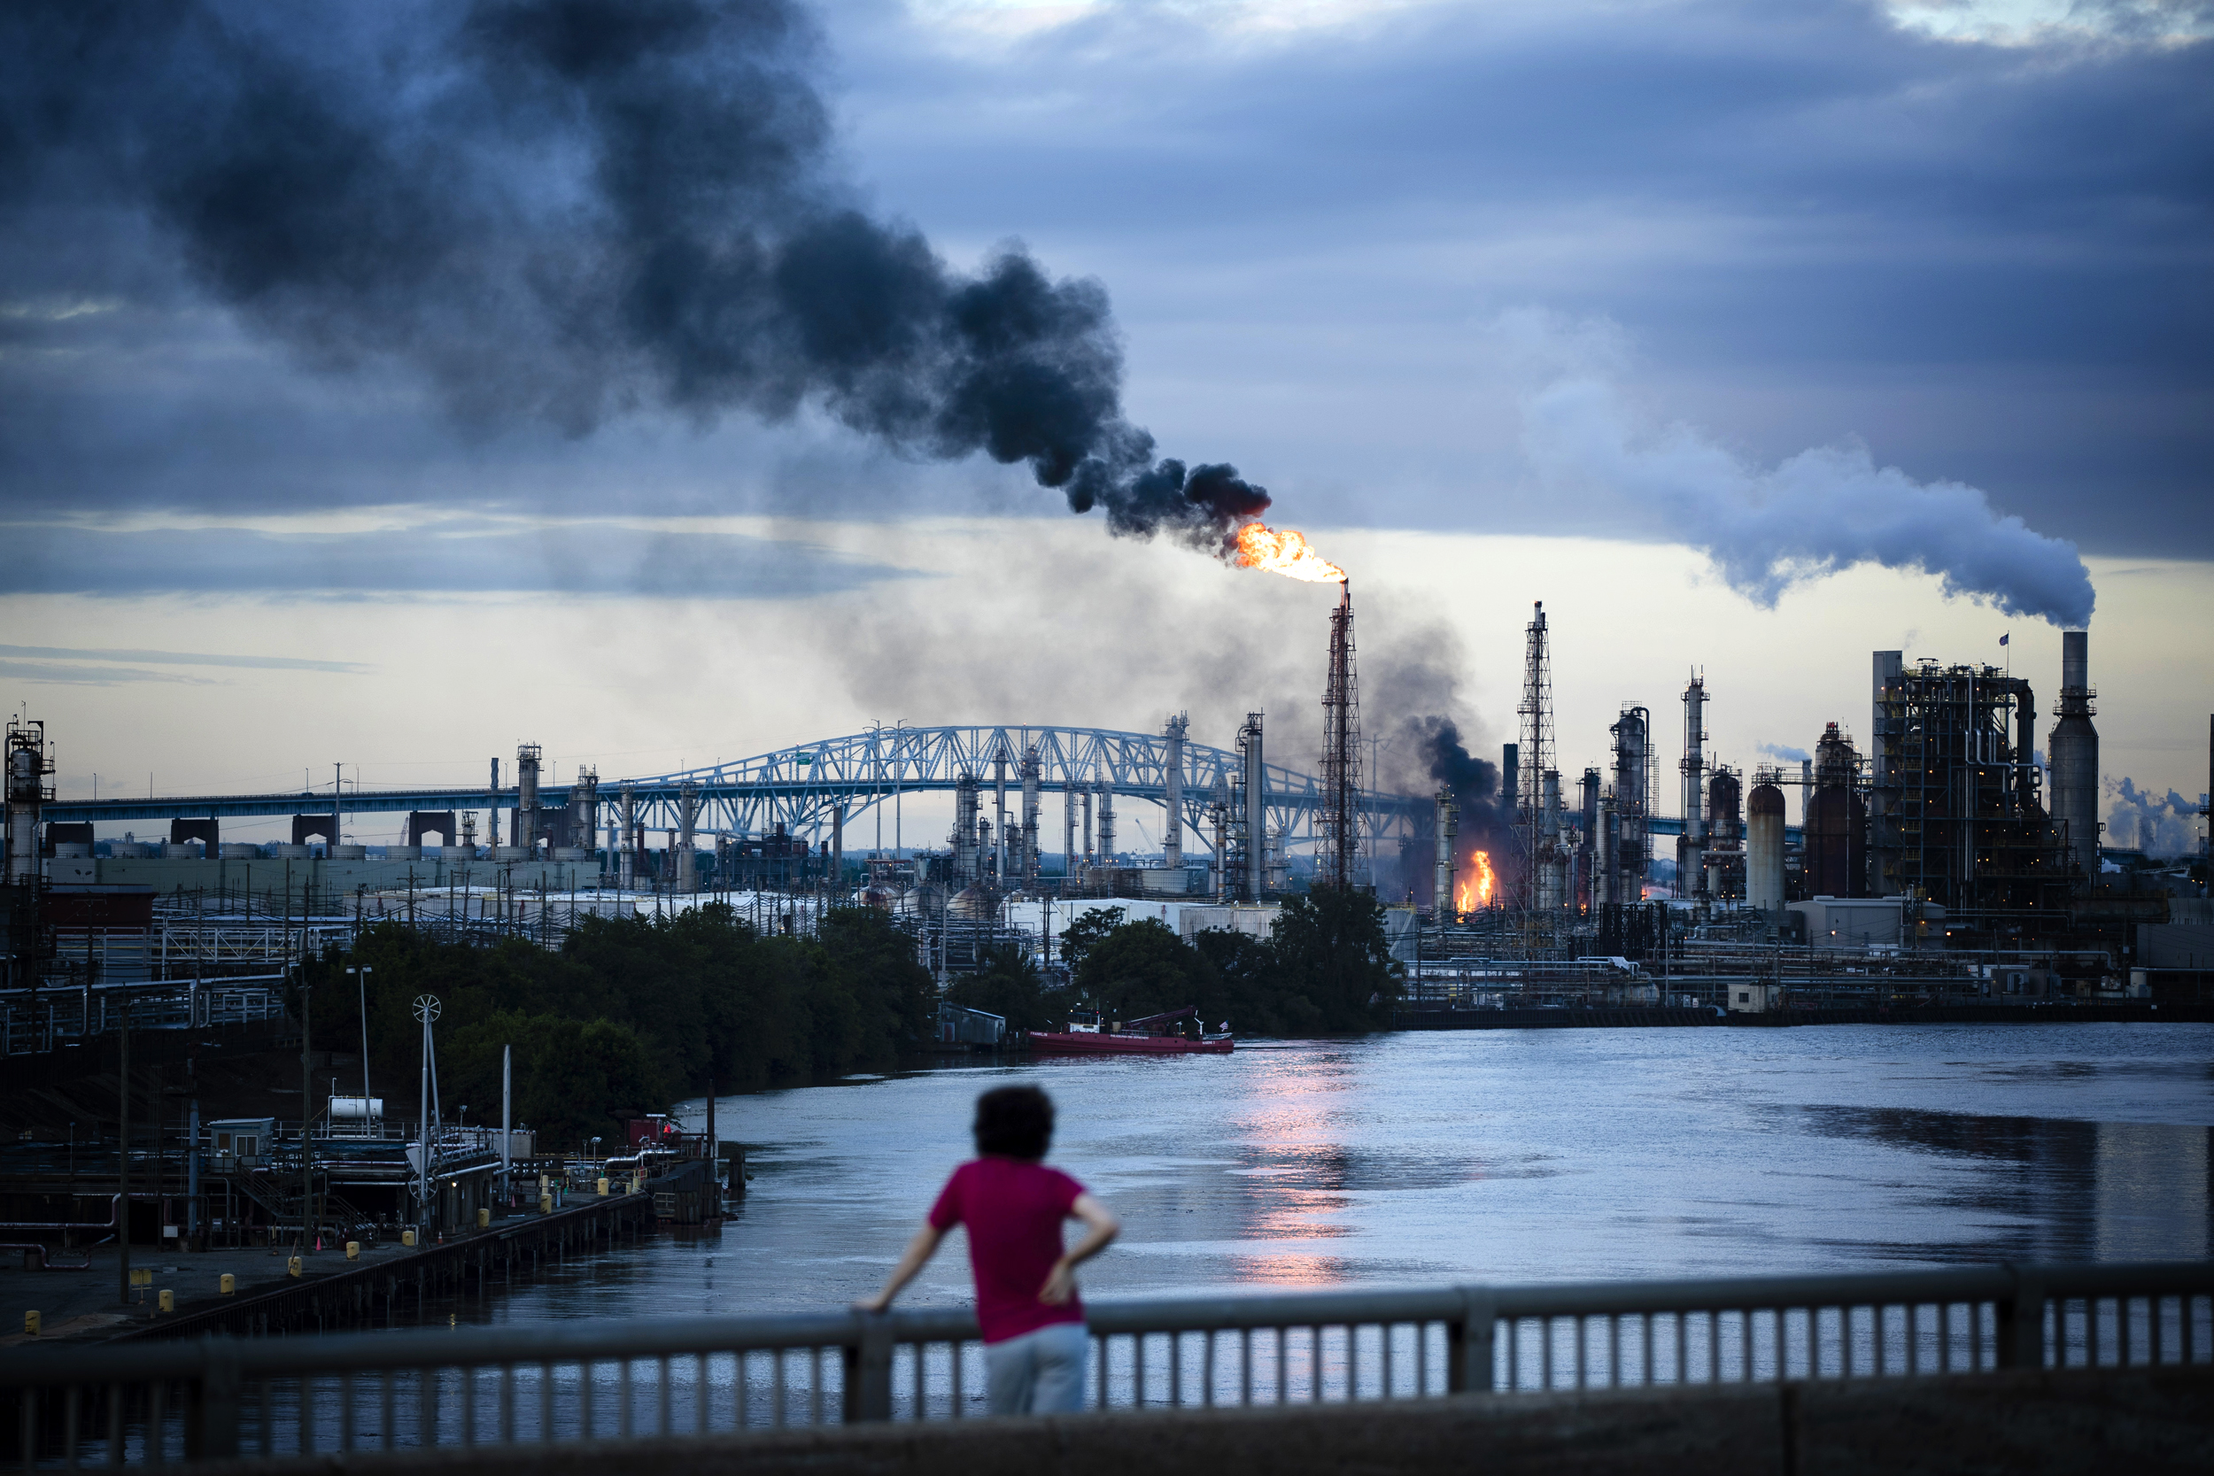
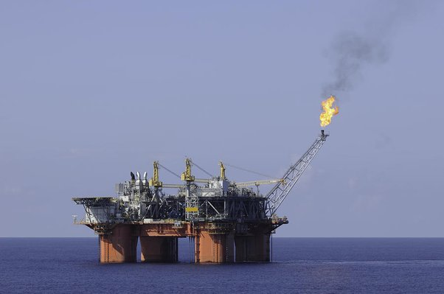
Fossil fuels
Oil rigs & oil refineries Oil rigs collects crude oil from the earth then it will be processed at oil refinery plants then vehicles consumes the refined product as a fuel type emitting huge quantities of Co2 this creates major issues with pollution
Notes:
Sources https://en.wikipedia.org/wiki/Oil_refinery

Slide 6
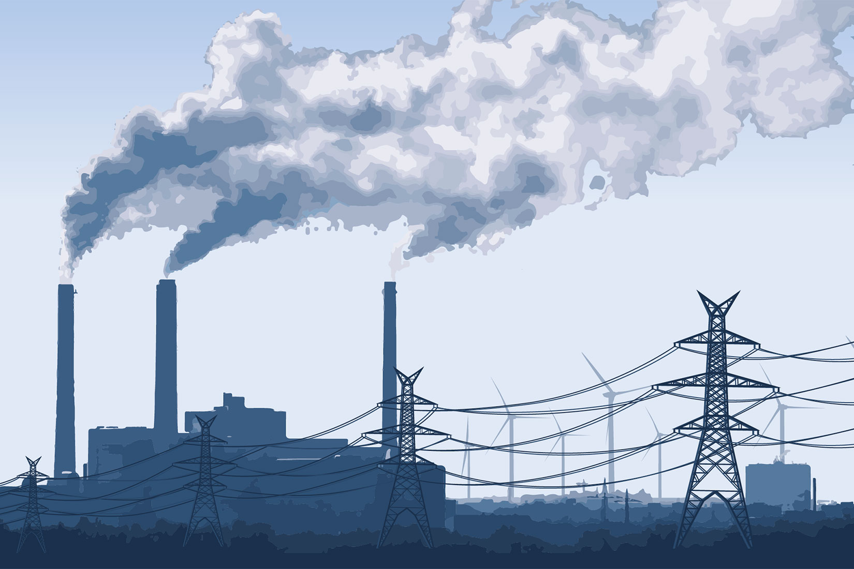
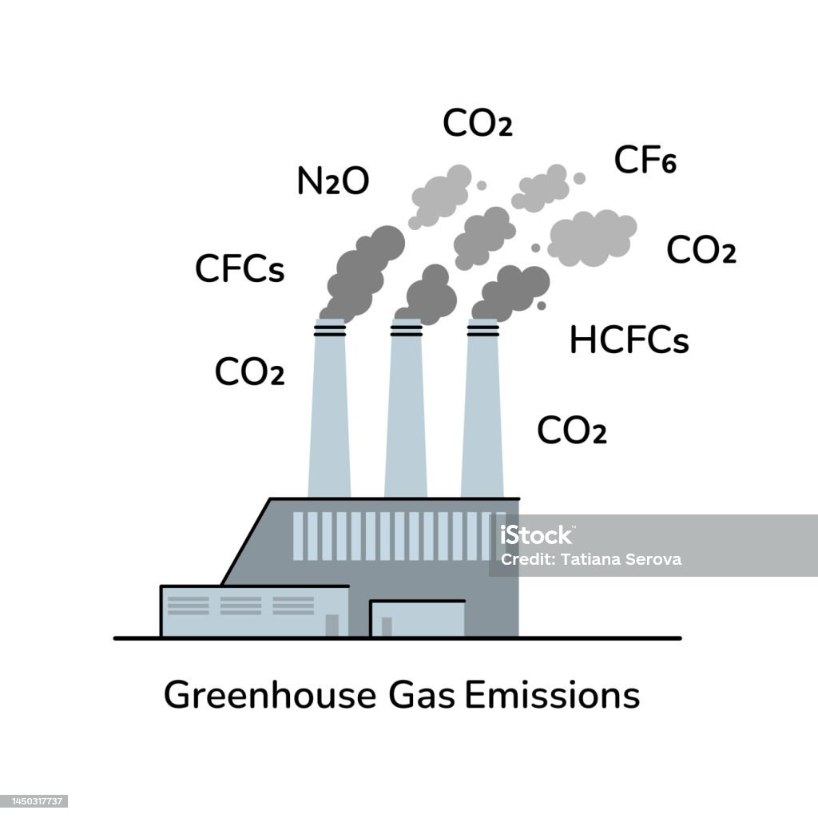
Fossil fuels
gas-fired power station Operating a gas-fired power station emits nitrogen oxides that creates smog that can cause respiratory health issues and long time exposure can cause chronic lung disease
Notes:
Sources https://environmentaldefence.ca/2023/02/10/five-reasons-natural-gas-is-bad-for-you-and-the-environment/

Slide 7
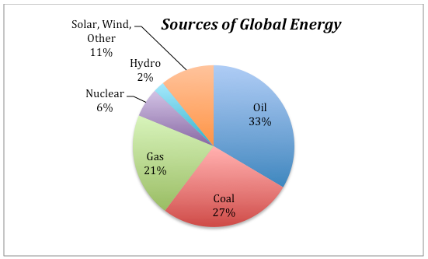
Fossil fuels
The issues with fossil fuels such as coal, oil & gas Fossil represents 80% of the world's energy production this is a horrible solution for humans and especially the environment
Notes:
Sources https://www.dr.dk/drtv/se/den-groenne-optur_-kan-vi-bygge-solen-paa-jorden_323949 https://ourworldindata.org/co2-emissions

Slide 8
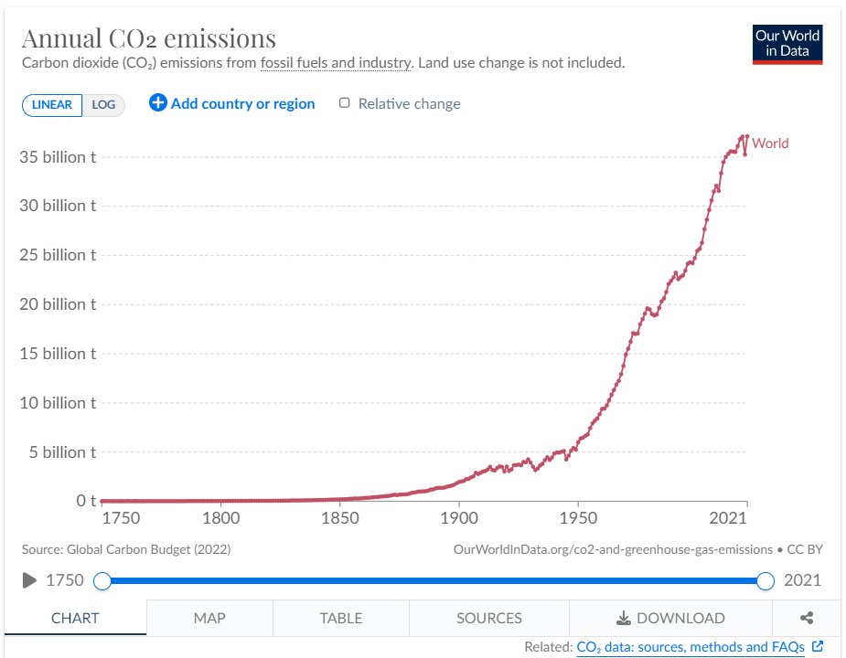
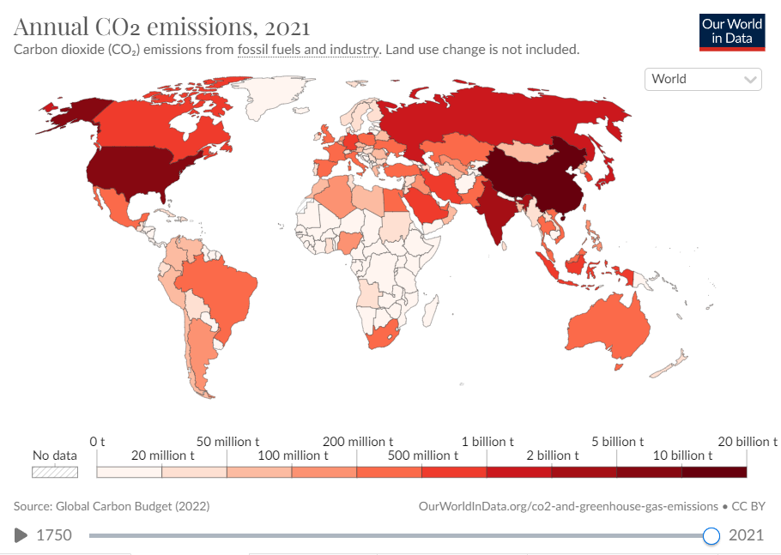
Co2 emissions
Blew the scale in 100 years In 1900 roughly 2 billions tons of Co2 was emitted and in the year 2000 roughly 25 billions tons of Co2 was emitted that’s over 10 times then what was emitted 100 years ago n 2021 Denmark emitted roughly 30 million tons of Co2 that’s 5000 tons of Co2 per citizen
Notes:
Sources https://ourworldindata.org/co2-emissions

